Slide 1
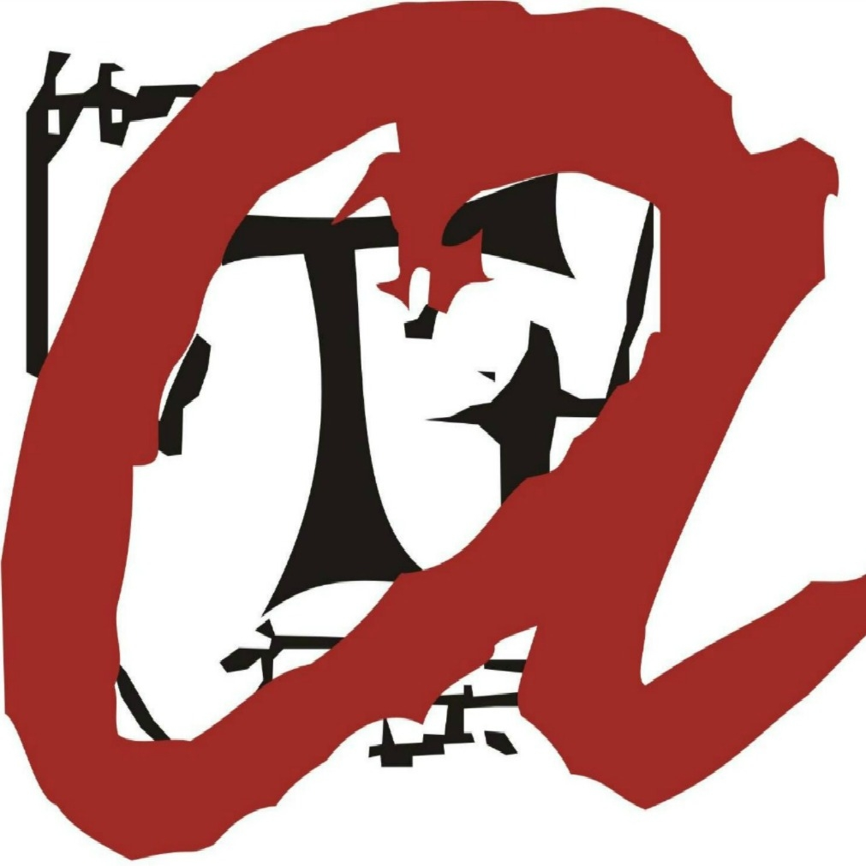
Final implementation of the practical exercise
Aleix Toda Mas Álvaro Romero Diaz
Jordi Riu Jorge Alexander
Josep Famadas

Slide 2
Index
Final architecture and changes
New turn game settings
Found metal fields to assign
Metal field assignation
New turn desired actions
Results

Slide 3
Final architecture and changes

Slide 4
Important changes with regard to the design
Gold and silver sub-coordinators deleted
Utility Computing: does not take into account distance between prospectors
Parameter optimization in our “Selectivity method”
Diggers agents always prioritize mining over manufacturing
INDEX
Final architecture and changes
New turn game settings
Found metal fields to assign
Metal field assignation
New turn desired actions
Results

Slide 5
Multi-Agent System final architecture
System Agent
INDEX
Final architecture and changes
New turn game settings
Found metal fields to assign
Metal field assignation
New turn desired actions
Results
Digger coord.
Coordinator Agent
Prospector coord.
Digger
Prospectors
Digger
Prospectors
Digger
Prospector

Slide 6
New turn game settings

Slide 7
New turn game settings
INDEX
Final architecture and changes
New turn game settings
Found metal fields to assign
Metal field assignation
New turn desired actions
Results
System Agent
1
Digger coord.
2
Coordinator Agent
2
Prospector coord.
3
3
3
Digger
Prospectors
Digger
Prospectors
= Game Settings
Digger
Prospector
= Utility map

Slide 8
Found metal fields to assign

Slide 9
Found metal fields to assign
INDEX
Final architecture and changes
New turn game settings
Found metal fields to assign
Metal field assignation
New turn desired actions
Results
System Agent
Digger coord.
3
Coordinator Agent
2
Prospector coord.
1
Digger
Prospectors
Digger
Prospectors
Digger
Prospector
= found metals
= all found metals

Slide 10
Metal field assignation

Slide 11
Metal field assignation
INDEX
Final architecture and changes
New turn game settings
Found metal fields to assign
Metal field assignation
New turn desired actions
Results
System Agent
Digger coord.
Coordinator Agent
Prospector coord.
1
3
2
Digger
Prospectors
Digger
Prospectors
= list of metals
Digger
Prospector
= bids of diggers
= metal assignation

Slide 12
New turn desired actions

Slide 13
New turn desired actions
INDEX
Final architecture and changes
New turn game settings
Found metal fields to assign
Metal field assignation
New turn desired actions
Results
System Agent
3
3
2
Digger coord.
Coordinator Agent
Prospector coord.
2
1
1
Digger
Prospectors
Digger
Prospectors
= movement intention
Digger
Prospector
= digging intention
= manufacturing intention

Slide 14
Results

Slide 15
Results
 | Execution 1 | Execution 2 | Execution 3 | Execution 4
Benefits | 2296 | 2369 | 1500 | 1588
Manufactured Gold | 140 | 156 | 74 | 123
Manufactured Silver | 138 | 130 | 108 | 74
Average benefit for unit of metal | 8.26 | 8.28 | 8.24 | 8.06
Average time for discovering a metal | 53.16 | 67.15 | 34.18 | 28.56
Average time for digging a metal | 74.86 | 91.42 | 88.75 | 79.57
Ratio of discovered metal | 0.94 | 1.00 | 0.96 | 0.95
Ratio of collected metal | 0.31 | 0.31 | 0.26 | 0.26
INDEX
MAS final architecture
New turn game settings
Found metal fields to assign
Metal field assignation
New turn desired actions
Results

Slide 16
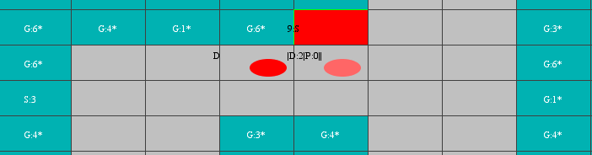
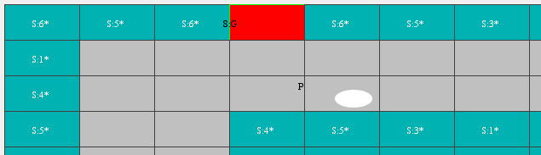
Results: emergent behavior
Final turn cells around a gold manufacturing center
INDEX
MAS final architecture
New turn game settings
Found metal fields to assign
Metal field assignation
New turn desired actions
Results
Final turn cells around a silver manufacturing center

Slide 17
Real demo

Slide 18
Questions

